Slide 1
GPS Dilemma
UOIT IEC Group 1
[ariLotter, anthonyDeSouza, lysisMejias, joshuaPineda]

Slide 2

problem_description
create an autopilot program for GPS navigation in 2D

Slide 3

program function
Input
time that signal is received by plane
coordinates of destination point
amount of signal sources available
for each signal source:
heading of signal source
time signal source sends signal
satellite coordinates at initial time t = 0
Output
compass heading from the receiving location to the destination, in degrees
where many locations are consistent with the signals -> inconclusive
no possible locations consistent with the signal -> inconsistent”.

Slide 4

algorithm
text

Slide 5

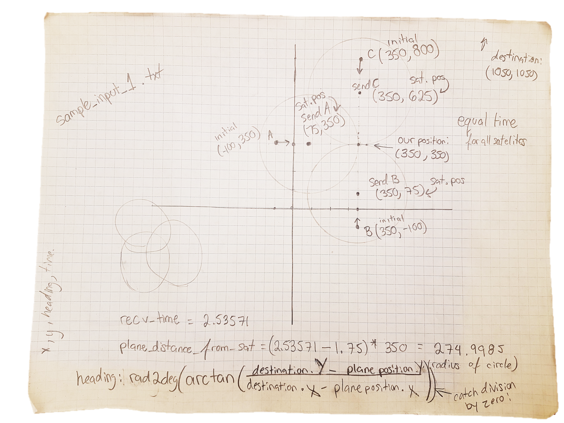

preliminary analysis

Slide 6
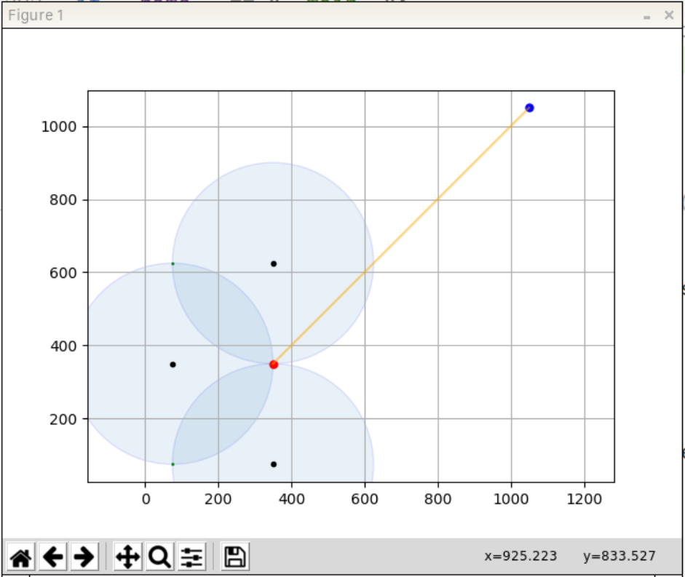
visualizing program output
Created a graphical output for debugging the code using matplotlib.pyplot

Slide 7
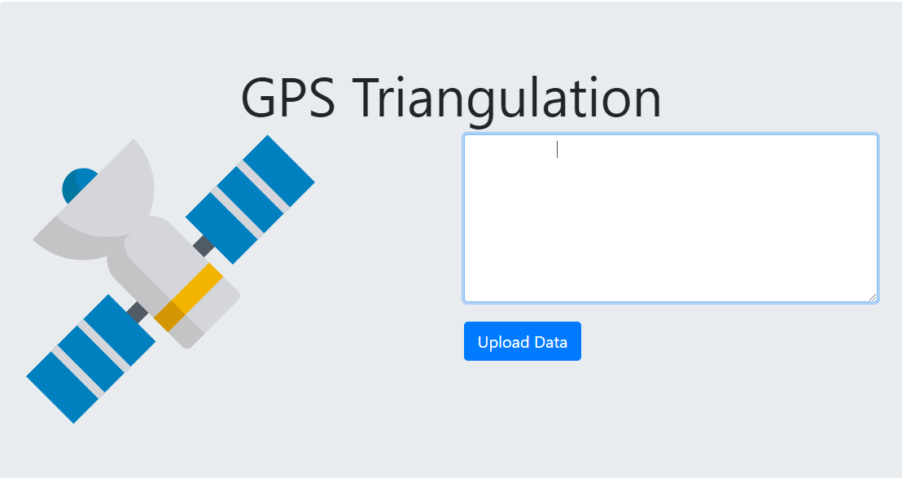
designing the GUI
Made a web-based GUI using Bootstrap and Chart.js

Slide 8

optimizing the process
We used an intuitive algorithm
Exit early if invalid data detected as to not waste time and system resources
Our algorithm runs in less than 1 ms in most cases.

